Slide 1
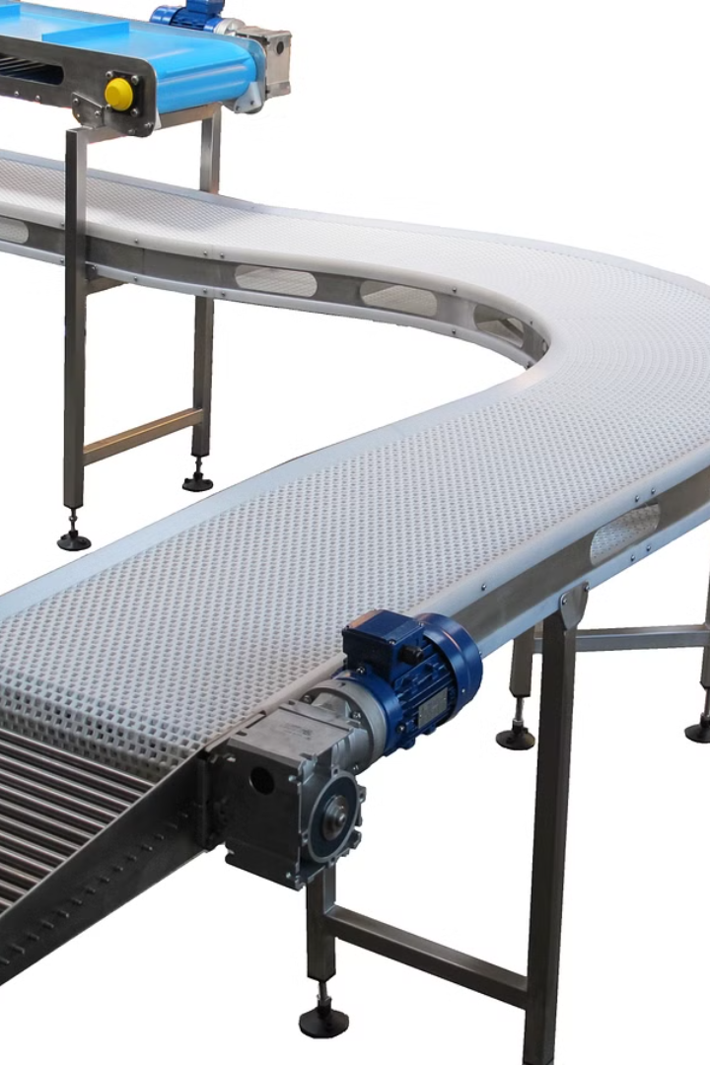

OBJECT SORTING MACHINE WITH CONVEYOR BELT SYSTEM
Presented by :
Vaibhav Nrupnarayan
Harish Bagul
Abhiman Bade

Slide 2

Problem Identification
Industrial Needs:
1
Describe the current issues with manual sorting processes (e.g., labor-intensive, prone to errors, slow processing times).
2
Current Issues:
Highlight the need for automated solutions in industries (e.g., manufacturing, packaging, recycling).

Slide 3
Objectives
Main Objective:
Specific Goals:
To develop an automated object sorting machine with a conveyor belt system.
Increase sorting speed and accuracy.
Reduce labor costs and manual errors.
Improve overall efficiency of the sorting process.

Slide 4
Literature Survey
1
Existing Systems:
2
Technological Advances:
Review of existing sorting systems and their limitations
Summary of recent advances in automation and conveyor belt technologies.
3
Case Studies:
Overview of similar implementations in different industries.

Slide 5



Methodology
System Design:
Components:
Describe the overall design of the system.
List and explain the key components (e.g., conveyor belt, sensors, sorting mechanisms).
Architecture:
4
Implementation Steps:
Include a block diagram of the system architecture.
Step 1: Hardware setup (installing conveyor belt, sensors, actuators, etc.).
Step 2: Software development (programming for sensor data processing, control algorithms).
Step 3: Integration (combining hardware and software components).
Step 4: Testing (functional testing, performance testing, user acceptance testing).

Slide 6
Approximate Budget
Approximate Budget : 10,000 Rs – 11000 Rs includes:
- PLC :2000
- Delta PLC Colour detection :3500
- MS Colour Mark Sensor 24 VDC SMPS : 3000
- Push Pull Solenoid Valve : 1000
- Johnson Geared DC Motor : 1000

Slide 7
Approximate Budget
Project Planner
Timeline:
understanding Requirements and component gathering : 2 week interfacing components : 4week Fabrication and testing : 4 weeks
Budget:
8500 to 1000

Slide 8
Probable Outcomes
Increased Efficiency: expected improvement in sorting speed and accuracy.
Cost Savings: Reduction in labour costs and errors.
Scalability: Potential for scalability to handle different types and volumes of objects.
User Feedback: Anticipated positive feedback from users due to the enhanced efficiency and reliability.

Slide 9
Conclusion
Final Thoughts:
Emphasize the potential impact of the project on industrial sorting processes and overall productivity.
Implementation Challenges:
Discuss any expected challenges during implementation and potential solutions.
Future Prospects:
Highlight the future prospects and possible advancements of the project.

Slide 10
References
https://www.industrybuying.com/sensor-accessories-multispan-IND.SEN.85259955/?srsltid=AfmBOoryeoC7XrQgoW9lLq1uuV4LRSI3z0HSjJV7NLQAEA9Detbkr_8POrA
https://www.vishay.com/docs/37484/lcd016n002bcfhet.pdf
https://www.amazon.in/Techtonics-Johnson-Geared-Motor-Grade/dp/B08GG6WX1W?source=ps-sl-shoppingads-lpcontext&ref_=fplfs&psc=1&smid=A394MJGYEIL46Y
https://www.tradeindia.com/products/sick-color-sensors-c5482001.html

Slide 11
Thank You

